Slide 1
Interns Project Presentation
by
Ankit Kumar| Ayush Verma

Slide 2
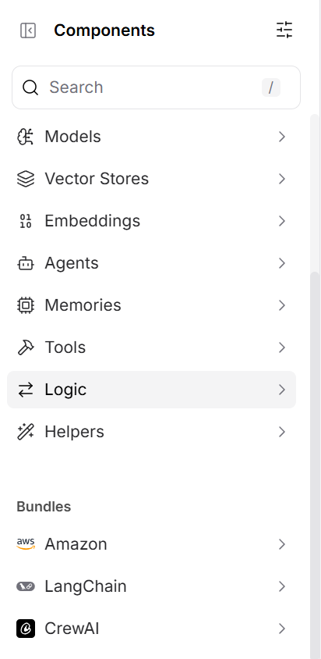
Stripped Langflow version
Removed unnecessary dependencies from the Langflow instance like bundles, models, embeddings, etc.
Reduced number of packages leads to quicker builds and smaller deployment size.
Cleaned up heavy JS and CSS bundles for faster loading and improved performance.

Slide 3
AISHA UI with stripped Langflow
Successfully integrated the streamlined langflow backend with AISHA UI.
User can access powerful Langflow features within their existing query hub.
Visual Builder of AISHA have role based access for controlled functionality.

Slide 4
Orchestrator Agent with recommendation Capabilities
A custom Langflow component as an intelligent orchestrator for the ESD workflow.
Automatically identify the intent and provides smart recommendations to support decision making.
Fully powered by a LLM for dynamic, intelligent process orchestration.

Slide 5
Langflow Runner (Flow as a Tool Component)
Developed a Langflow component that enables one flow to call another within or across multiple instances.
Simplifies workflows by breaking them into manageable, modular components.
Establishes flows as a callable tools, enabling flexible and scalable workflows.

Slide 6
Orchestrator Agent using CAG approach (k-v cache)
Developed orchestrator and planner agents for hierarchical multi agent systems.
Leverages Cached Augmented Generation to Optimize efficiency and reduce model interaction costs.
Enables intelligent planning, data retrieval, and automation for advanced workflows and decision support.

Slide 7
Thank You

